Slide 1
Using Machine Learning Algorithms in R for Breast Cancer Predictions

Slide 2
Introduction
Breast cancer is something that has been around since ancient greece, and it continues to be a risk for women if they don’t get regularly tested.
According to the breascancer.org website and UCdavis university the survival rate when found early is 99%.
Roughly 13% or about one in eight U.S women will develop invasive breast cancer in the course of their life.
This is why its important that there is a preventative way to seek help and have accurate screenings for breast cancer.

Slide 3
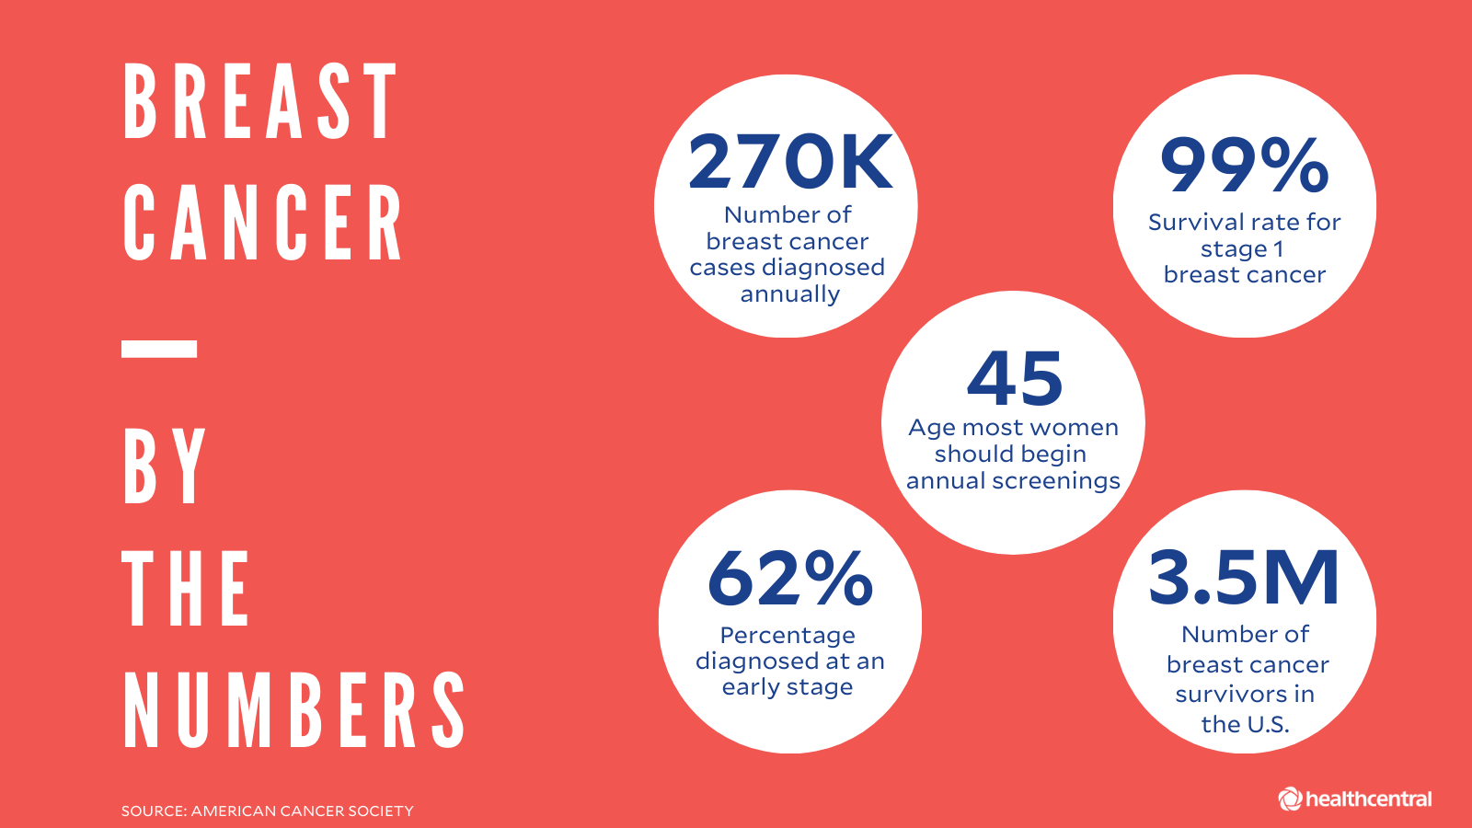

Slide 4
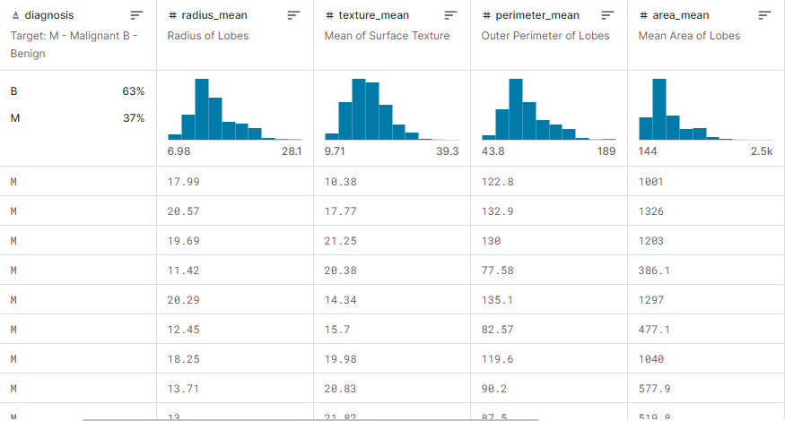
The data
In order to find a way to view this problem I found a data set that was modeled on the wisconsin breast cancer data. Found here https://archive.ics.uci.edu/dataset/17/breast+cancer+wisconsin+diagnostic.
This dataset from kaggle can be found here https://www.kaggle.com/datasets/yasserh/breast-cancer-dataset
Here is a snippet of the data- As you can see in the data there are 63% benign and 37% malignant. There are also 32 features, with 569 observations.

Slide 5
The models
Now the purpose of this model is to take the feature diagnosis that has the data points of malignant and benign and use them in order to determine whether the tumor is one of those two categories.
In order to do this I will be using 4 models. Logistic regression, Random Forest, GLM net, and Support Vector Machine.
Each of these models has their own advantages and disadvantages, so we can find which of these is the best model overall for the dataset.

Slide 6
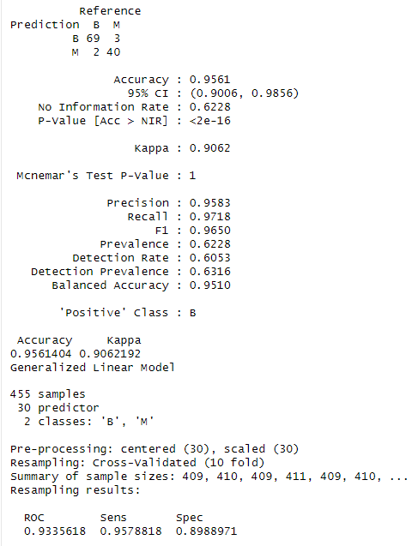
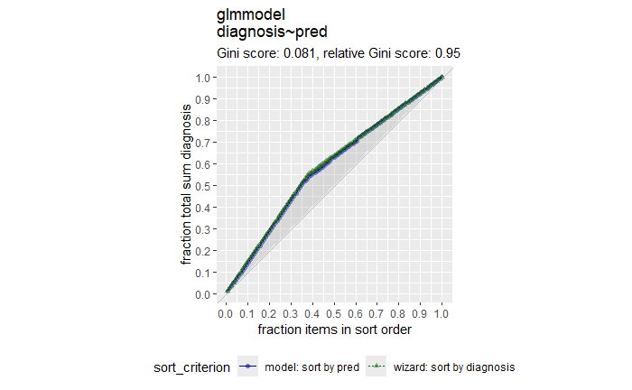
GLM model
I made the glm model in Rstudio three different ways in order to make sure that the data was correct and all the same regardless of the way you did it.
I did it with tidymodels and tidyverse, using the recipe and workflow functions.
Next I did it with the glm function and making my own model
Lastly I used the caret package to make one as well.
This is a curvegain plot used to check how similar the actual and predicted values are.
With a gini score that low its fairly similar.
As you can see from the data its accuracy is 95.6 %

Slide 7
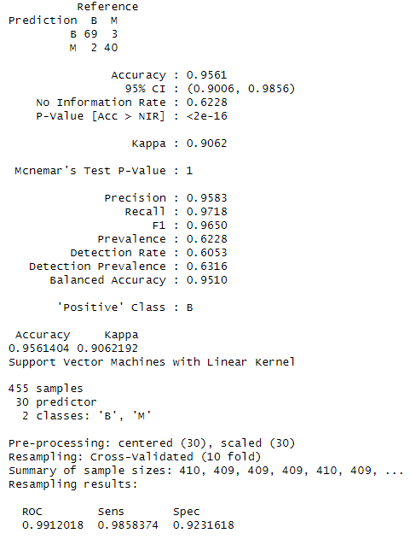
SVM (support vector machine
A support vector machine is a model in which is uses a hyperplane to identify data as either red or blue. This classifies each of them into a category to see which side they fit on.
Using this I found that I got an accuracy of 95.6% which is the same as the glm function.

Slide 8
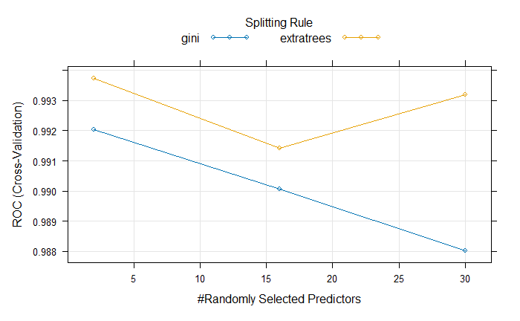
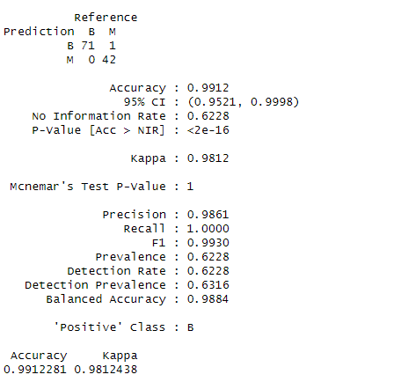
Random Forest model
What this does is it takes in the dataset, puts them into different groups and has each “expert” vote on a final decision. These subsets of data each contribute to the overall accuracy at the end along with its predictions.
These experts help figure out the model and the accuracy.
As you can see from the model it has an accuracy of 99%.
One thing to note is that I have the tuning meter set to 3 and each run of the forest will give a different accuracy. It averages out between 98-99% and rarely ever has went under those.

Slide 9
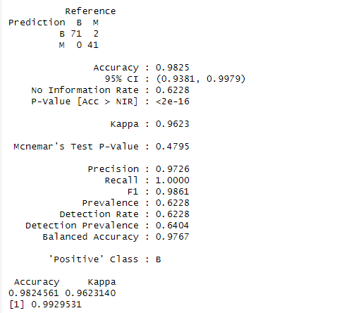
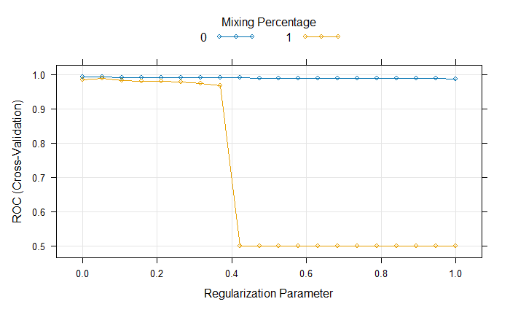
GLMnet model
This is a package that fits generalized linear and similar models via a penalized maximum likelihood. It uses regularization as a method to prevent overfitting which also uses the lasso, ridge, and elastic net regression to do this.
The accuracy for this model is 98.3%
This graph shows the differences in how the lasso and ridge regularization.

Slide 10
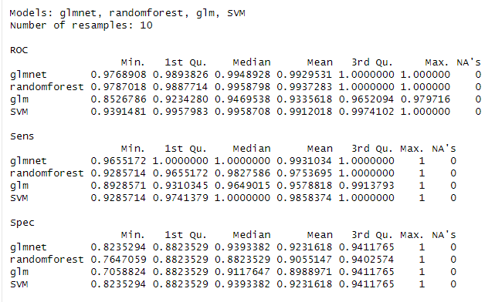
Conclusion
Looking a the comparisons you can see that a lot of models have a high accuracy. The one who ends up having the highest overall is the random forest, but the glmnet is the most consistent while being only slightly worse.

